Slide 1
Antibiotics- Past, present and future
Nick Bateman

Slide 2
200 years ago bacteria were unknown Key developments
Immunization- Edward Jenner 1796 cowpox
“Germ theory” 1800’s (‘Miasmas in the air’)
Hand washing in Vienna Semmelweis 1847 – reduced mortality from puerperal fever from 10-35% to <1%
Cholera in London- John Snow 1854

Slide 3
Germ theory of disease
Pasteur’s “Germ Theory” 1859
“Pasteurisation” of wine- heating to 55 degrees in 1863;
1879 experiments on chickens lead to:-
1881 vaccine for anthrax; 1885 vaccine for rabies and subsequently for diphtheria
In Glasgow Lister 1865 developed antiseptic surgery based on Pasteur’s theories using carbolic acid
Body responds to infection- Convalescent human serum used in 1918 influenza epidemic- (most recently for Ebola patients)

Slide 4
Development of more specific treatments for infection
Attempts to treat diseases caused by infections since antiquity
Understanding of infectious disease in the 19th century- required culture of bacteria, microscopy, epidemiology, chemistry to synthesize treatments and some way to measure their effect
First treatments were toxic to patient and infectious agent- eg mercury used for syphilis in 1496.
“A night with Venus gives a year with Mercury”
First ‘targeted therapies’ Arsenicals developed in Germany by Paul Ehrlich in 1910 for parasites
‘Salvarsan’ (arsphenamine)

Slide 5
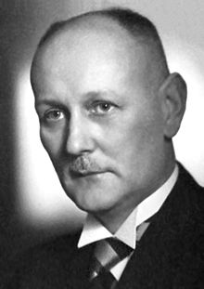
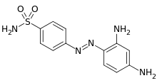
Gerhard Domagk (Nobel Prize winner 1939)
Based on original German work on coal tar extracts was studying dyes as antibacterials
Noted that the red dye Prontonsil Rubrum was effective in infection control in mice.
Prontonsil patented by Bayer in 1935 as the first sulfonamide antibiotic.
Many sulfonamides synthesised
Reputed to have saved thousands of lives in the 2nd world war. Used before penicillin.
Other drugs from this structure are sulfonylureas (diabetes), diuretics (heart disease and hypertension) and sulfasalazine (inflammatory bowel disease) .

Slide 6
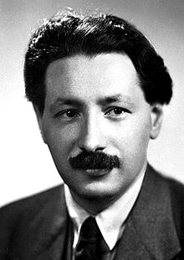
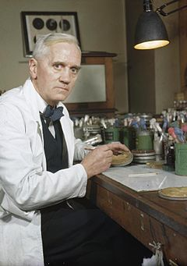
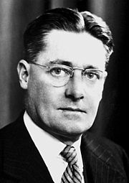
Fleming
Studied penicillin mould in 1928
First successful medicinal use in Sheffield in Nov 1930 for gonococcal infection in infants
Florey
Worked on the first clinical trials of penicillin:-
“ a drug made in a bath and passed through the Oxford police “
Chain
Synthesized penicillin and went to USA with Florey to get large quantity manufacture underway

Slide 7
What is the correct name?
Antibiotic:- kills or prevents growth of bacteria, derived from fungus or bacteria
Antibacterial:- kills or prevents growth of bacteria, natural or synthetic chemical
Antiviral:- kills or prevents growth of viruses (eg HIV, hepatitis)
Antifungal:- kills or prevents growth of fungi
Antimicrobial:- includes all the above

Slide 8
Search for new naturally synthesized antibiotics (“Bugs that kill bugs”)
Streptomycin the first ‘aminoglycosides’. Rutgers University USA in 1943 in lab of Waksman, (also discovered neomycin). Derived from Streptomyces griseus.
Major use in TB
MRC trial 1946-7. First “double blind” and randomised clinical trial.
Revolutionized the management of TB.
Many other families of antibiotic discovered subsequently

Slide 9
Discovery of major antibiotic groups
Penicillins 1930’s
Aminoglycosides 1943
Cephalosporin 1948
Carbapenem 1976
Fluoroquinonolones 1980
Since then…………

Slide 10
Why do the drugs kill the bugs and not you?
In general they target a system in a bacterium that is different to humans
eg. Sulfonamides effect folic acid metabolism (competitive inhibitors of dihydropterate reductase). The sensitivity of the bug is different to humans as we eat folate and bugs do not!
Penicillin affects the synthesis of the bacterial cell wall (not shared by human)

Slide 11
Why do the drugs kill the bugs and not you?
Penicillins prevent synthesis of the rigid cell wall that surrounds some bacterial cells
Human’s do not have this as part of their cells
Streptomycin inhibits the synthesis of a bacterial protein. As this occurs in many bacterial types streptomycin has a “wide spectrum” of activity.
BUT Streptomycin is also toxic to humans causing deafness, balance problems and kidney injury.

Slide 12
“ Narrow” and “Broad” spectrum drugs
This refers to the numbers of different types of bacteria targets
In general we now think narrow spectrum is better- the problem is that at present it is very difficult to diagnose many bacterial infections quickly enough, or at a sensible cost
Obviously culture is a possibility, but at least 24 h needed to grow, with further time for ‘sensitivity’
In GP broader spectrum antibiotics may thus often be required

Slide 13
1960’s “Golden age”
It was thought that infections would be no longer a problem
Use in animals as ‘growth promoters’ began

Slide 14
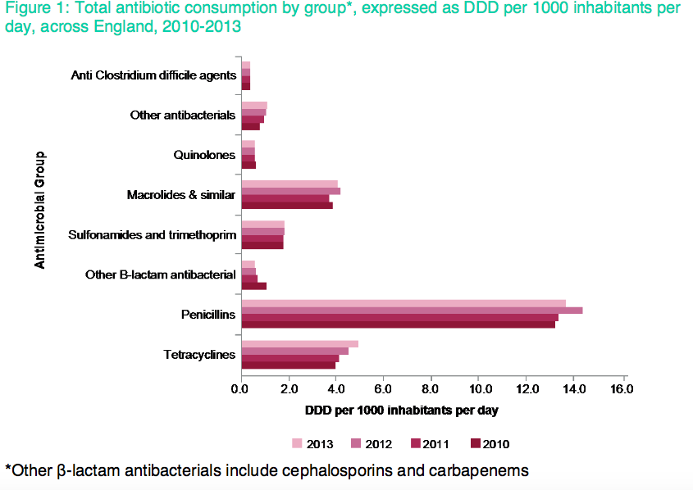
1 in 40 pop /day:
of which DoH estimates 20% not needed

Slide 15
Complications of antibiotics
Due the drug itself
eg Allergy and rashes (penicillins)
Effects on bone marrow (cotrimoxazole)
Effects on specific organs (gentamycin)
Due to the drugs effects
eg Changes to gut flora
Due to effects on the target bacteria
eg Drug resistance

Slide 16
Drug resistance
Bacteria selected out that are able to resist the effect of the antibiotic
Eg Penicillinase an enzyme that destroys penicillin
This happened very quickly in TB with streptomycin and multi-drug regimens were developed to try and prevent this

Slide 17
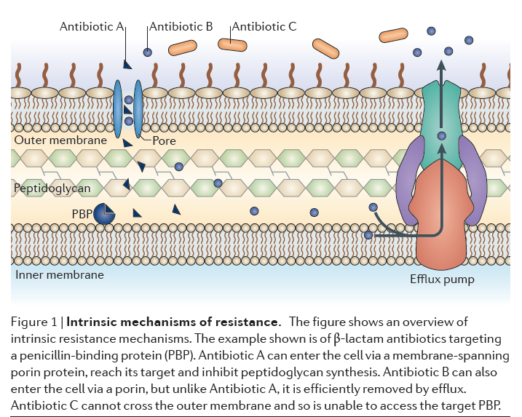

Slide 18
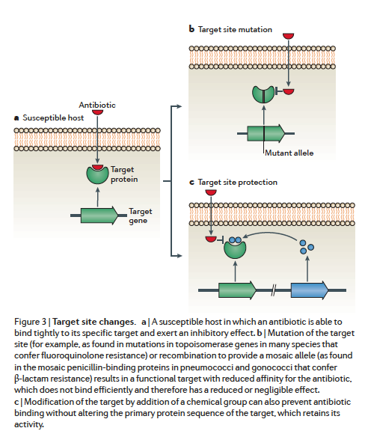
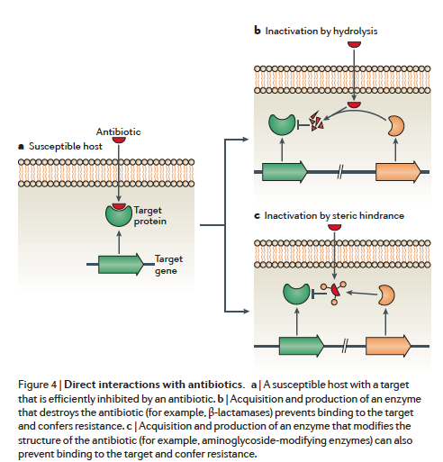

Slide 19
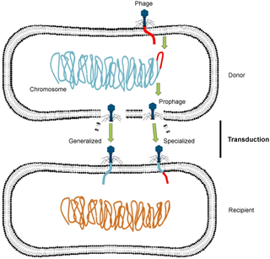
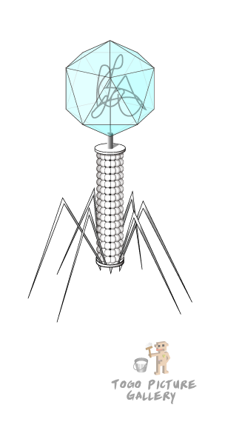
Bacteriophages- spread resistance and ? more
Viruses that carry information between bacteria
Potential use as a treatment (not easy!)
At present spread resistance- in hospital sewage!!!
Bacteriophages spreading DNA between two bacteria, a process known as transduction.

Slide 20
First detected in Japan.
In 2011 in San Francisco 9% of bacteria contained the altered gene. When he analyzed the bacteria in the lab these bacteria possessed partial resistance to cephalosporins, the only antibiotics that still work reliably and inexpensively against gonorrhea.
Scientific American 2012

Slide 22
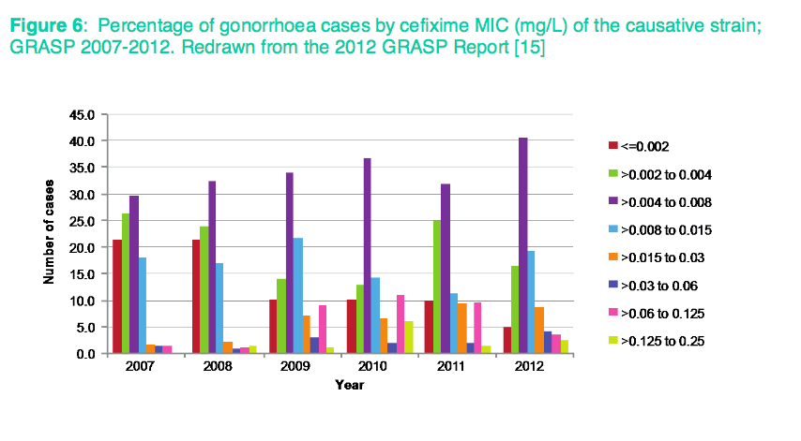

Slide 23
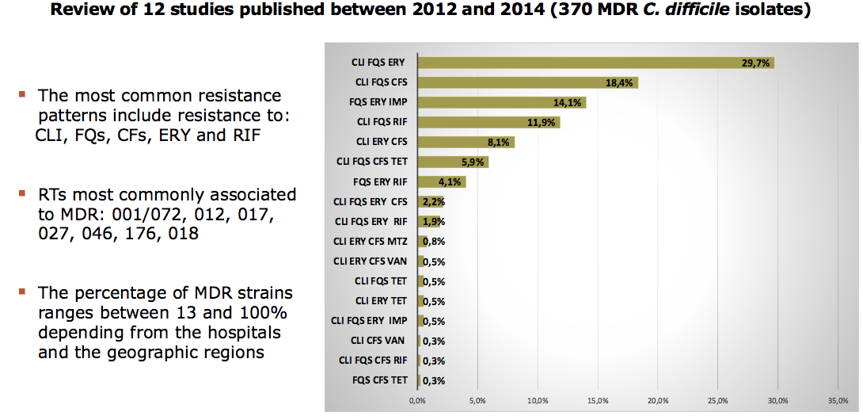

Slide 25
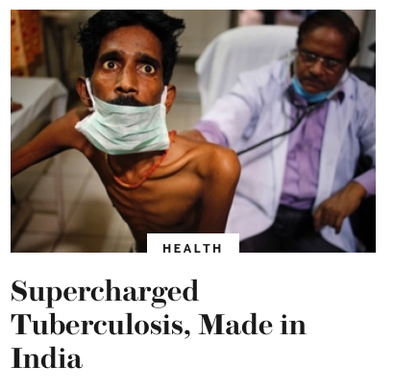
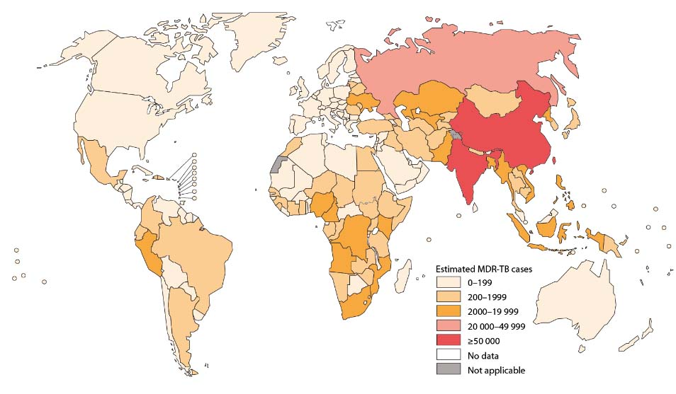
MDR TB
Scientific American

Slide 26
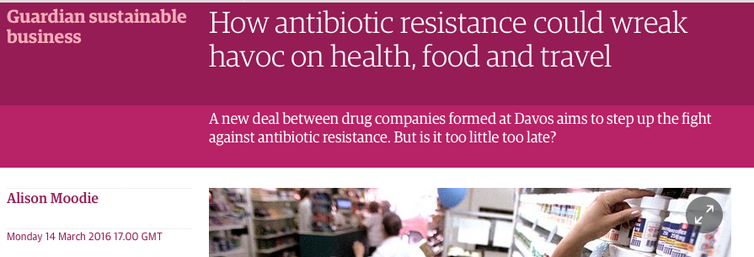

Slide 27
The future
New antibiotics?
Manipulating bacteriophages
Restriction of antibiotics to those who need them
Appropriate use and control of antibiotics in TB and other infectious diseases
Patient screening to exclude ‘carriers’ from hospital

Slide 28
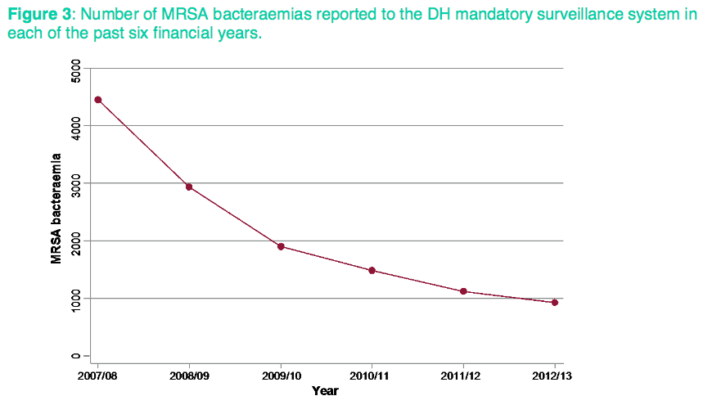

Slide 29
New antibiotics?? Proving a new antibiotic works in man
Penicillin- no other treatments
Streptomycin- MRC trial
Today
Clinical trials are necessary for licensing and sale
Hugely expensive to mount and run
Cost return means that increasingly industry developing very expensive drugs with a specific target

Slide 30
Conclusion
WHO plan to try and control antibiotic misuse and address resistance
DoH strategy to encourage GPs not to prescribe unnecessarily
EU strategy in place
Even George Osborne is worried!!
Will these strategies work? Lets hope so!!

